Slide 1
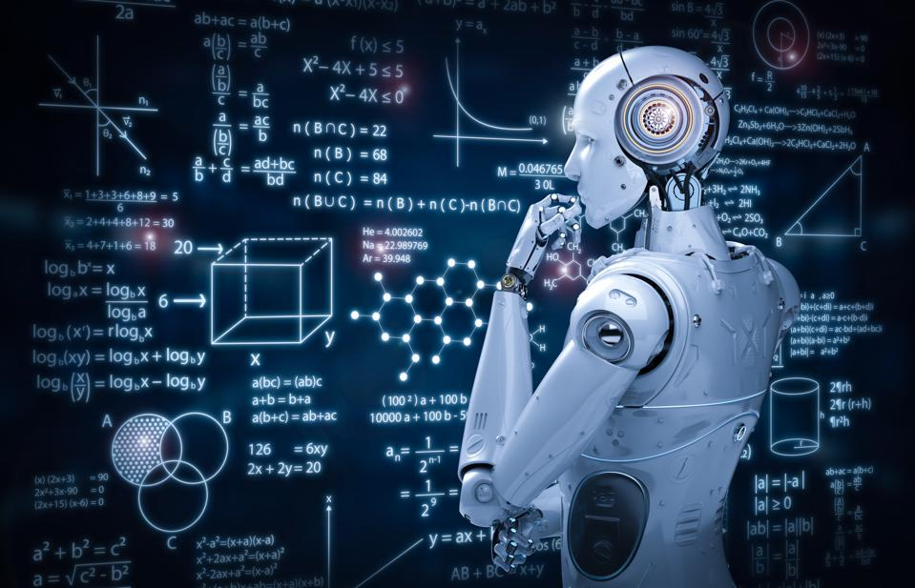
Machine Learning
Machine learning is basically the training of a machine to operate tasks better than the humans
We can train our model using machine learning to perform various predictions, analysing and more….
By-AVI PRUTHI

Slide 2
Important terms used:
1.Classifcation:- in which model draws a conclusion from observed fit i.e finds the decision boundary.
Like creating a model to check if mail is spam or not, problems like yes/no , speech recognition comes under the category of classification.
2.Regression:- in which model tries to estimate the best fit line i.e finds relation among variables
Eg. Weather prediction, house price prediction ….etc

Slide 3
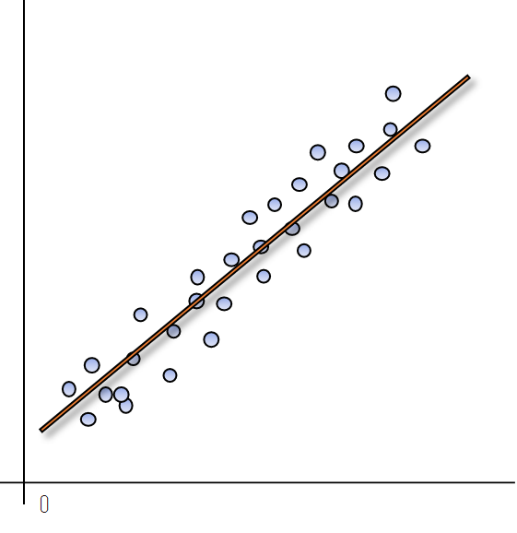
1.Linear Regression
Is used to predict a dependent variable value based on a given independent value.
Eg: For single variable->
Y=mx+c (y<-dependent, x<-independent)
Eg: for multiple variables->
Y=mx1+mx2+…..+ mx….
Used for predicting continuous data

Slide 4
Working of this Algorithm-
Importation-
from sklearn.linear_model import LinearRegression
Initialization and training:
reg=LinearRegression.fit(x_train,y_train)
Calculating model score:
reg.score(x_test, y_test)

Slide 5
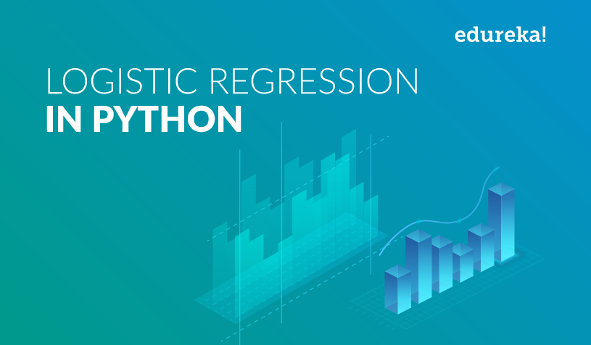
2.Logistic Regression
Used for predicting categorical data(data which can be divided into groups)
Mainly used for classification-binary,multiclass

Slide 6
Working
Importation:
from sklearn.linear_model import LogisticRegression
Initialization, training and predicting score
Reg=LogisiticRegression().fit(X_train,y_train)
Reg.score(X_test,y_test)

Slide 7
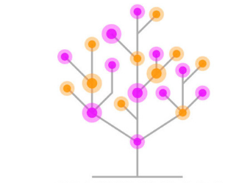
3.Decision-Tree
Trains the dataset with if-else-then conditions i.e it is used mostly where there is dependencies on previous/other variables.
It can be used for classification as well as regression problems
Works on concept of less entropy(less randomness).

Slide 8
Working
Importation:
from sklearn import tree
Initialization, training and predicting score
clf = tree.DecisionTreeClassifier().fit(x_train,y_train)
clf.score(x_test,y_test)

Slide 9
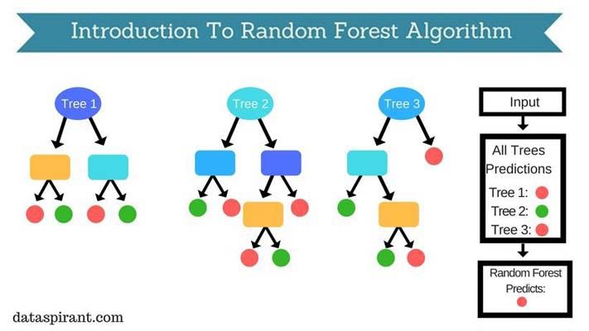
4.Random Forest Classifier
Is a set of decision trees from a randomly selected subset of the training set and then it collects the vote from different decision to decide the final predictions.
The main parameter used here is ‘n_estimators’ which basically determines the number of decision trees to be formed and on basis of their prediction a final Random forest model is formed

Slide 10
Working
Importation:
from sklearn.ensemble import RandomForestClassifier
Initialization, training and predicting score
clf = RandomForestClassifier(n_estimators=10).fit(x_train,y_train)
clf.score(x_test,y_test)

Slide 11
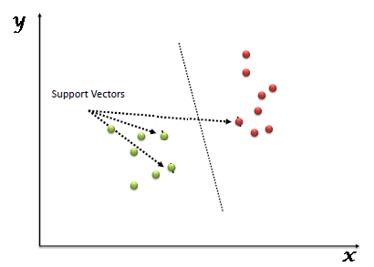
5.Support Vector Machine(SVM)
The goal of SVM algorithm is to create the best line or decision boundary that can segregate n-dimensional space into classes so that we can easily but the new data point in correct category in future.
The aim is to create a boundary line called hyperplane which is created so as to obtain maximum margin.
It is used for both classification and regression.

Slide 12
Working
Importation:
from sklearn.svm import SVC
Initialization, training and predicting score
clf =SVC().fit(x_train,y_train)
clf.score(x_test,y_test)

Slide 13
Types of Machine Learning
Supervised Learning:
which works with labelled data i.e in which inputs and target variables are known.
Techniques used in supervised learning are-
Classification
Regression
Algorithms based on them has already been discussed-linear regression, logisitic ….. Etc.

Slide 14
Unsupervised Learning:
works with unlabelled data in which the inputs and target classes are not known and we try to find various relationships between different features.
Techniques used here are-
Clustering- involves partitioning of dataset into groups called as clusters. The goal is to group data into similar clusters.
Association-involves to find the dependency of one data item on another so as to generate maximum profit.
Examples- K-means Clustering Algorithm, Principal Component Analysis etc…

Slide 15
Semi-Supervised Learning:
is a type of machine learning algorithm that lies between supervised and unsupervised machine learning.
It uses the combination of both labelled as well as unlabelled data during the training period.

Slide 16
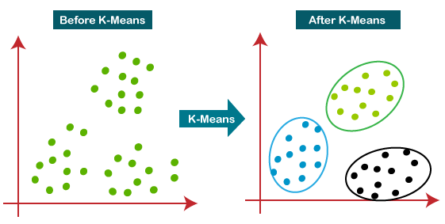
6.K-means Clustering Algorithm
Is an unsupervised machine learning algorithm that forms clusters of data based on the similarity between data instances.
The main parameter used is ‘ n_clusters‘ which separates the data and apply clustering technique to train and predict.

Slide 17
Working
Importation:
from sklearn.cluster import KMeans
Initialization, training and predicting score
clf=KMeans(n_clusters=3).fit_predict(x,y)

Slide 18
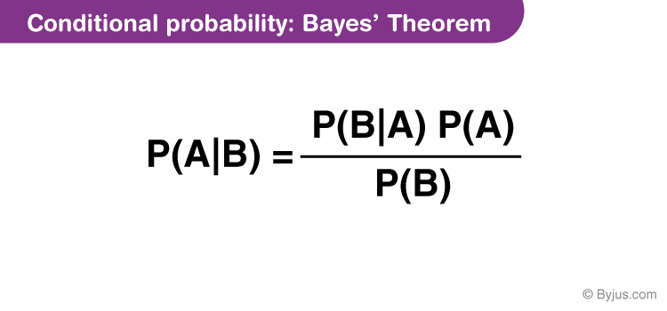
7.Naïve Bayes Classifier Algorithm
Is a statistical classification technique based on Bayes Theorem. It is one of the simplest supervised learning algorithm
It consists of 2 words –
Naïve which means every feature is independent of each other.
Bayes which means it used Bayes theorem

Slide 19
Basically Naïve Bayes is a collection of various algorithms-
1.Gaussian Naïve Bayes: is used when predictor values are continuous and are expected to follow Gaussian distribution.
2.Bernoulli Naïve Bayes: is used when predictors are Boolean in nature and are expected to follow Bernoulli Distribution.
3.Multinomial Naïve Bayes- makes use of Multinomial distribution and is often used to solve issues involving document or text classification.

Slide 20
Implementations
from sklearn.naive_bayes import GaussianNB
clf = GaussianNB()
from sklearn.naive_bayes import BernoulliNB
clf = BernoulliNB( )
from sklearn.naive_bayes import MultinomialNB
clf = MultinomialNB()

Slide 21
Reg.fit(x_train,y_train)
Reg.score(x_test,y_test)
Reg.predict(x_test)

